Slide 1
Resistance Facts
MTN-025 (HOPE Study)
Community Education Presentation

Slide 2
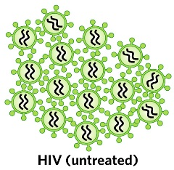
What is Resistance?
When a person becomes infected with HIV, the virus enters the person’s body and begins to make copies of itself.

Slide 3
What is Resistance?
The medicines used to treat HIV are called antiretrovirals (ARVs).
Notes:
Taking ARVs properly usually means taking 3 different ARV medicines, because it takes more than one ARV medicine to stop HIV from making copies of itself.

Slide 4
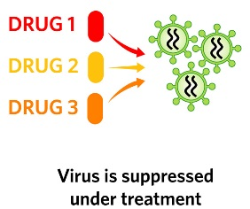
What is Resistance?
When taken properly, ARVs stop the virus from making copies of itself and help people with HIV to feel better and live longer.

Slide 5
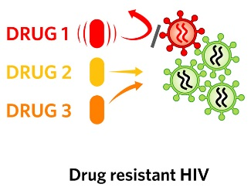
However, ARVs are not perfect, and sometimes they are not able to stop all of the HIV viruses from making copies.
What is Resistance?

Slide 6
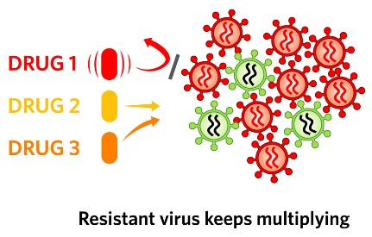
When this happens, the HIV that is able to continue making copies of itself is called “resistant.”
What is Resistance?

Slide 7
Why is resistance to ARV medicines a problem?
When resistance happens, the person needs to stop taking the ARV that is no longer working and start taking a different ARV medicine.

Slide 8
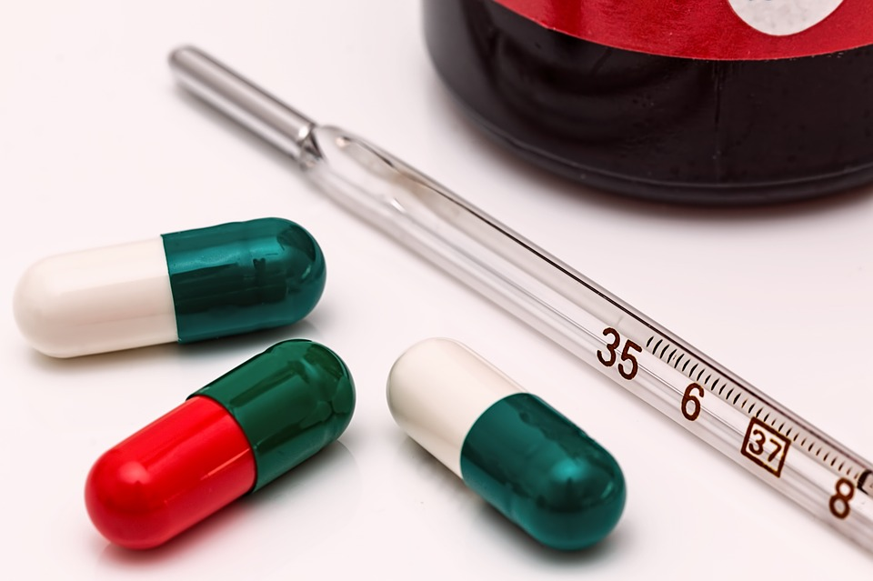
Why is resistance to ARV
medicines a problem?
Because of this, a person who has resistant HIV has fewer choices of ARV medicines that they can take to help them stay well.
Additionally, they could infect others with resistant virus.

Slide 9
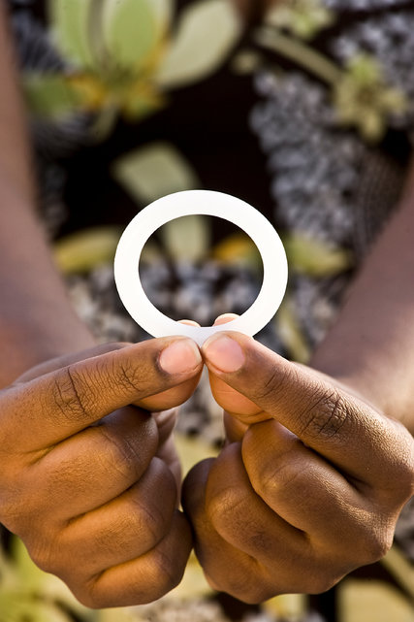
Why is resistance to ARV medicines a concern in this research study?
The vaginal ring contains an ARV called dapivirine. Dapivirine is being used only for HIV prevention, and is not used to treat persons infected with HIV.

Slide 10
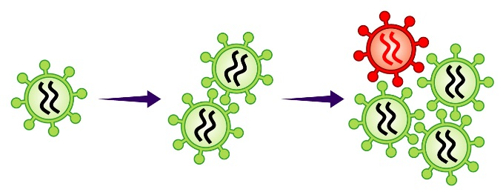
Why is resistance to ARV medicines a concern in this research study?
However, if a woman becomes infected with HIV and keeps using the ring, the virus in her body could become resistant to dapivirine and similar ARV medicines used for treating HIV or for preventing mother-to-child transmission of HIV.

Slide 11
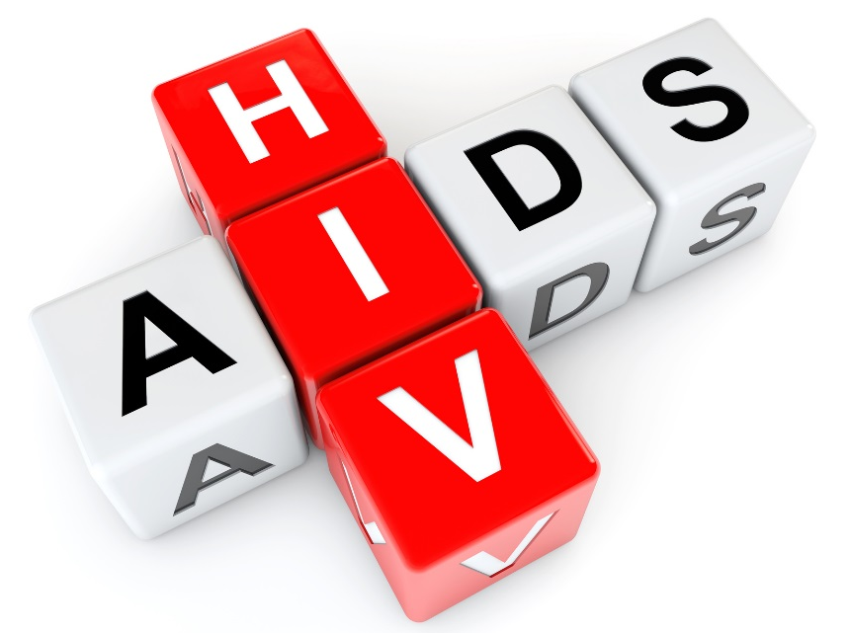
How can resistance to ARV medicines be avoided while participating in HOPE?
1. Avoid Getting HIV: Resistance to ARV medicines cannot occur in a person who does not have HIV.
Notes:
There are many things you can do to reduce your risk of HIV:

Slide 12
How can resistance to ARV medicines be avoided while participating in HOPE?
Use the dapivirine vaginal ring consistently
Use condoms consistently

Slide 13
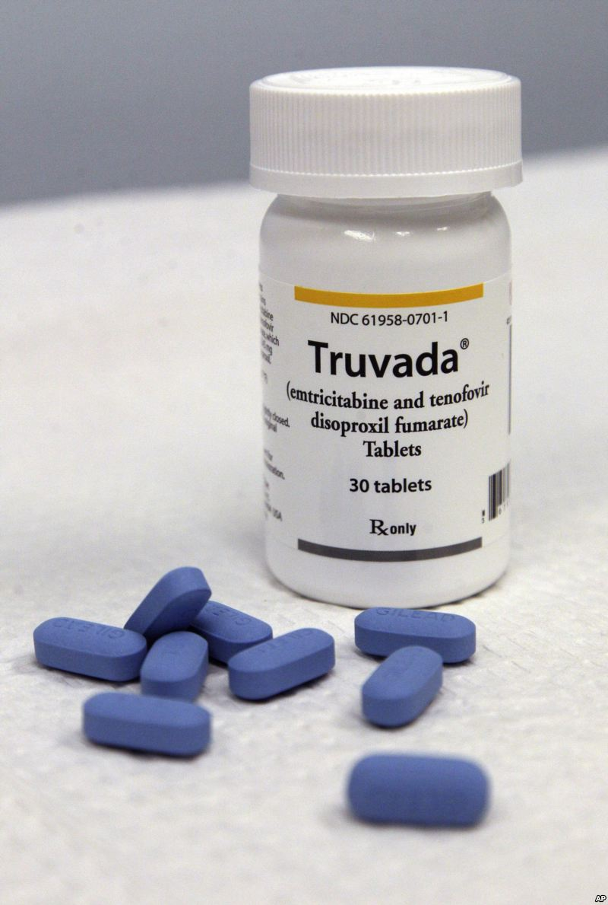
How can resistance to ARV medicines be avoided while participating in HOPE?
Use oral PrEP (e.g. Truvada)
Reduce your number of sex partners
Engage in lower-risk sexual behaviors

Slide 14
How can resistance to ARV medicines be avoided while participating in HOPE?
Encourage your partner to get tested for HIV
If your partner is HIV positive, encourage them to be adherent to their ARV medications
Notes:
Ask your counselor about the “Information about HIV Prevention Options” handout for more information on these options

Slide 15
How can resistance to ARV medicines be avoided while participating in HOPE?
2. Have Regular HIV Testing:
HIV testing will be done at every study visit.
You should also come to the clinic for HIV testing if you think you may have been infected with HIV between visits.

Slide 16
How can resistance to ARV medicines be avoided while participating in HOPE?
If testing shows you have HIV, it is important to immediately stop using the vaginal ring to help prevent resistance.
Notes:
If study visits are missed, a participant might get HIV, not know it, and keep using the ring. This could cause resistance to some ARV medicines.

Slide 17
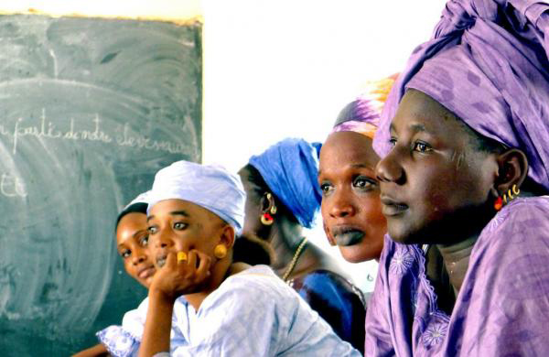
How can resistance to ARV medicines be avoided while participating in HOPE?
3. Do Not Share Vaginal Rings:
Participants in the research study get regular health checks and HIV tests.
People who are not in the study do not get these health checks. These people could have HIV, and not know it.
Notes:
If people who have HIV use the vaginal ring, this could cause resistance to some ARV medicines.

Slide 18
If you have questions or need more information, please visit the study clinic.
Notes:
The study staff are here to help.
Study staff are available to inform and counsel study participants, their partners, and other community members about resistance and any questions or concerns they may have.

